Slide 1

The Operating System of AI Age
POC Uis
June 2025

Slide 2
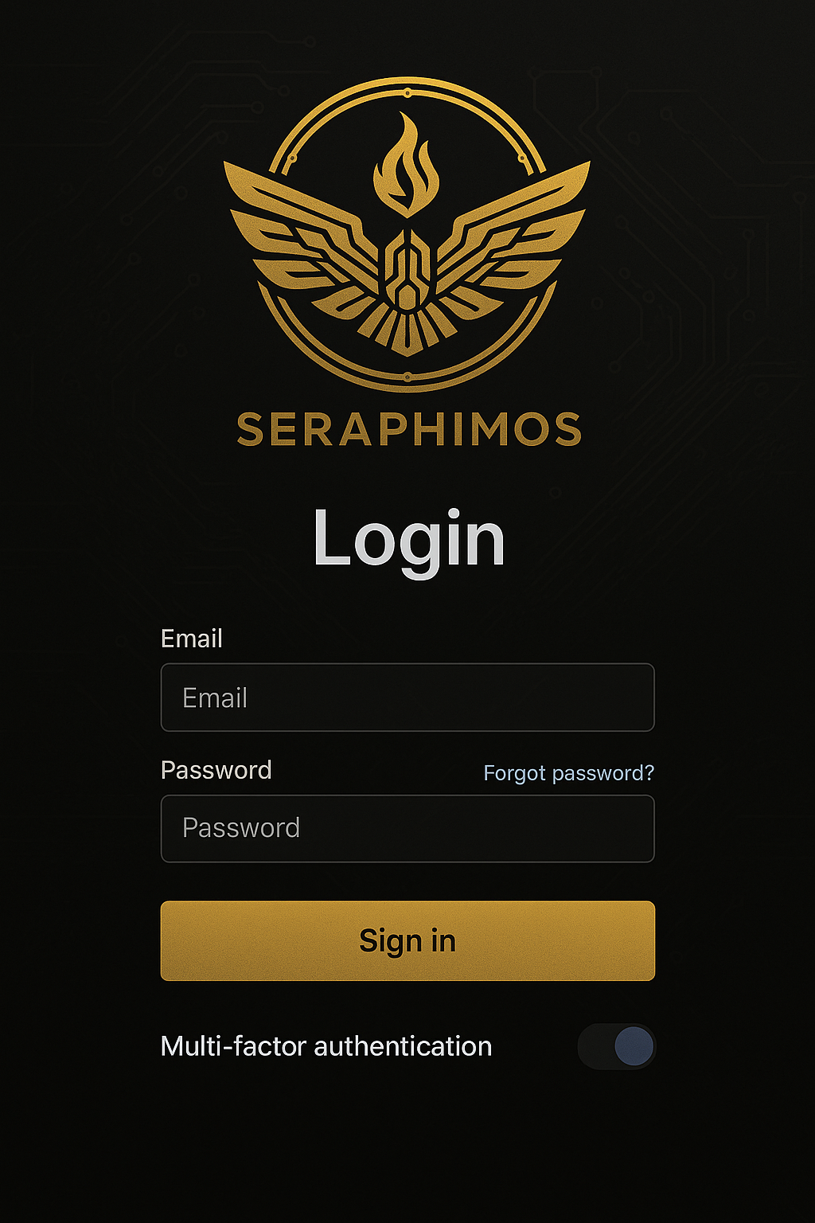
Login & Authentication
Elements
Login screen: Email/pass or SSO
MFA prompt screen: (if enterprise demo)
Role-based access redirect: (Admin vs Operator vs Observer)
Logic Flow
User submits credentials:
POST /auth/login
System verifies via Auth API:
If successful: retrieve JWT + orgID + user role
Load role-based dashboard:
GET /user/profile
GET /system/state → redirects to Mission Control
Special Logic
MFA if enabled: triggers POST /auth/mfa
Admins land on Mission Control; Viewers land on Audit screen
Notes:
© Copyright PresentationGO.com – The free PowerPoint and Google Slides template library

Slide 3
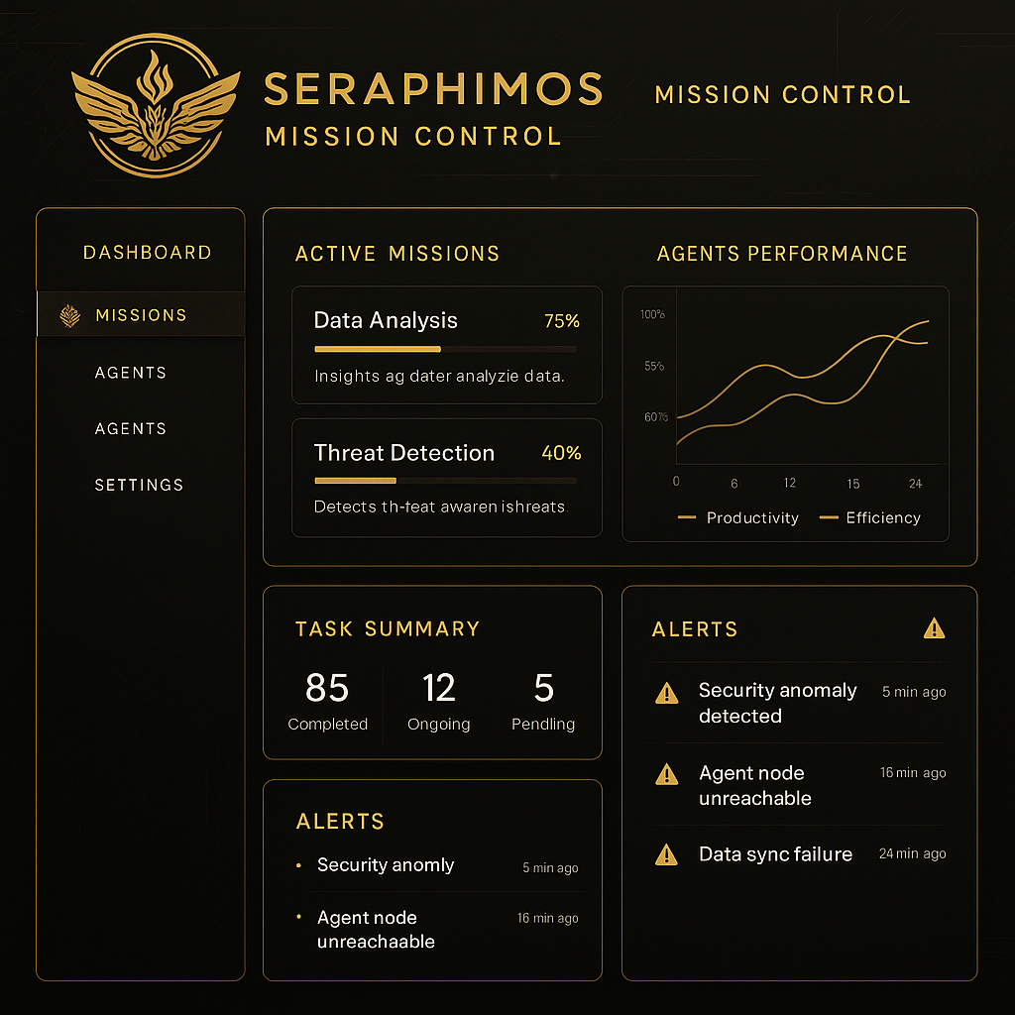
Mission Control Dashboard (Main OS Hub)
Your command center for managing agents, workflows, and system health.
Elements
System overview: CPU, memory, agent activity heatmap
Agent pulse/status panel
Real-time log feed (scrollable, filterable)
Notifications & alerts center
Logic Flow
Initial Load:
GET /system/metrics (CPU, mem, active agents)
GET /agent/status/all → pulls agent heartbeat
GET /notifications/latest
Real-time Log Stream:
WebSocket to ws://agent-logs-feed
Health Alerts:
Triggers red/yellow flag if threshold breached (from /system/health-check)
Actions
Clicking agent links to Orchestration Panel
Alert click triggers modal with diagnostics
Notes:
© Copyright PresentationGO.com – The free PowerPoint and Google Slides template library

Slide 4
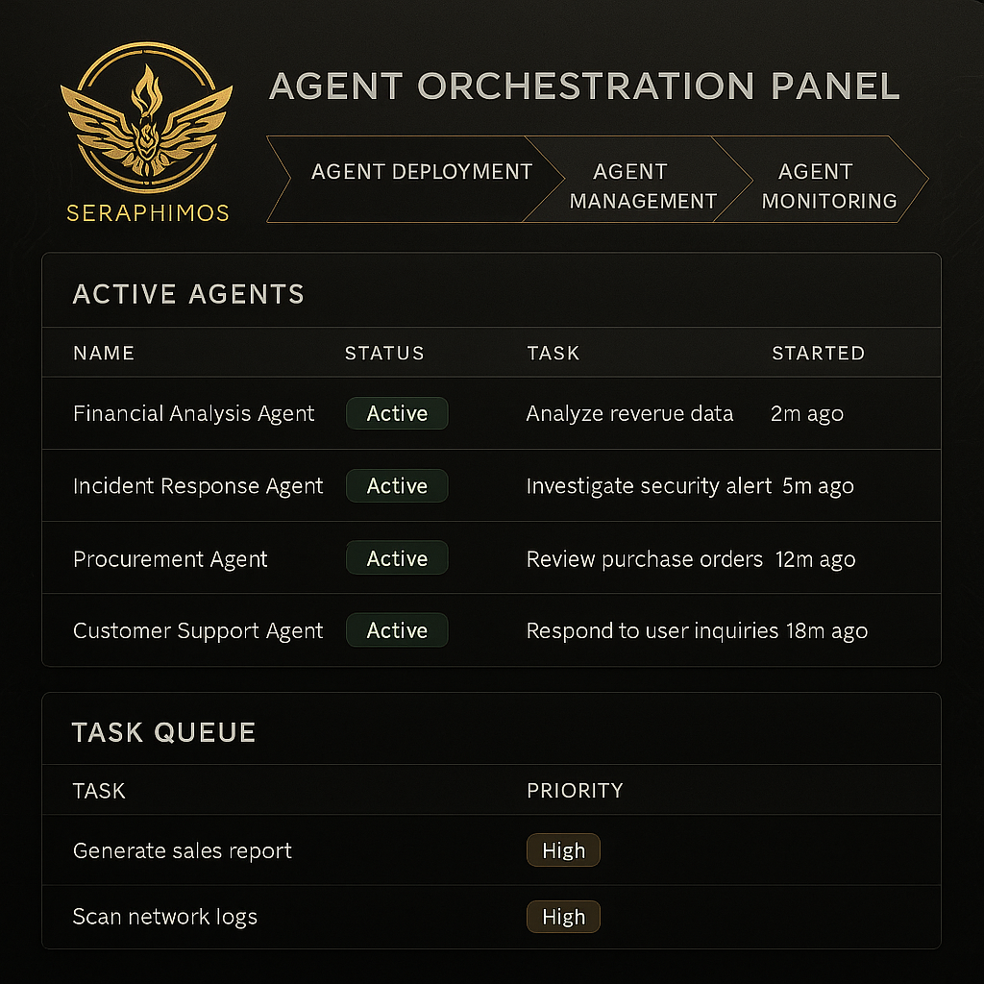
Agent Orchestration Panel
Where you deploy, manage, and chain agents.
Elements
Agent registry (library of all available agents)
“Create Agent Chain” wizard
Few-shot config editor (data, role, constraints)
Run, pause, or reset agents
Agent lifecycle logs (with timestamps, errors, outputs)
Logic Flow
Pull agent catalog:
GET /agents/registry
User selects or creates agent:
Opens AgentConfigModal
Configure Agent Chain:
Saves to POST /agent/chain/create
User hits 'Run’:
o Triggers POST /agent/execute
o Displays output via WebSocket or polling /agent/run/{id}/output
Special
Output Viewer logs success, error, latency
Chained agents visualize node by node
Notes:
© Copyright PresentationGO.com – The free PowerPoint and Google Slides template library

Slide 5
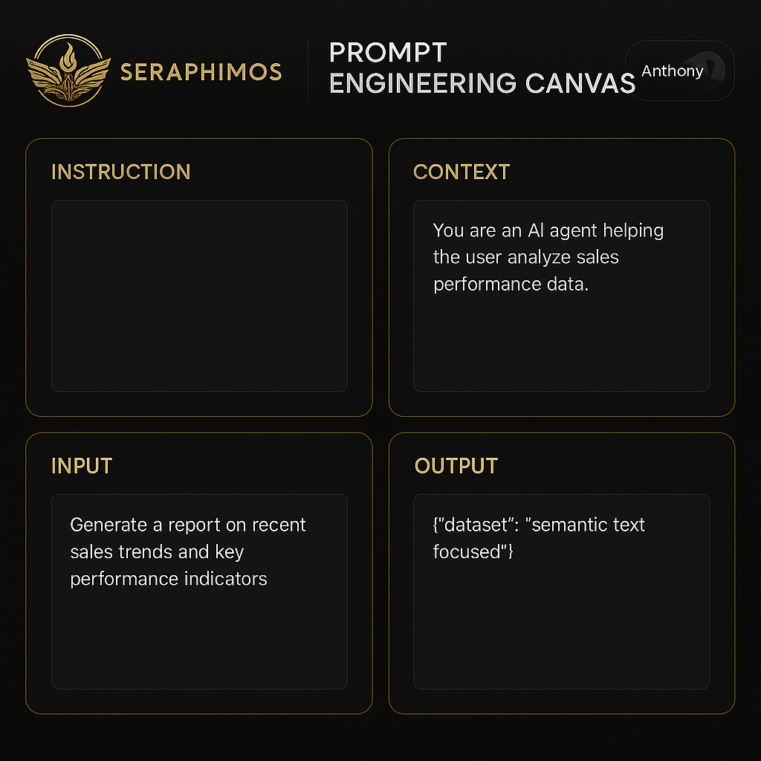
Prompt Engineering Canvas
Graphical interface for chaining few-shot prompts with input/output testing.
Elements
Visual node-based canvas (à la LangFlow or ReAct builders)
Prompt input and example output viewer
Add tool/memory/validator nodes
“Test Run” button and output inspector
Logic Flow
Load prompt config:
GET /prompts/{id}
Canvas loads as JSON map:
Nodes = {prompt, tool, validator, memory}
Live test:
POST /prompt/test-run
Shows response + token cost + latency
Special
"Chain to agent" → creates agent config from canvas
Save version: POST /prompt/save-version
Notes:
© Copyright PresentationGO.com – The free PowerPoint and Google Slides template library

Slide 6
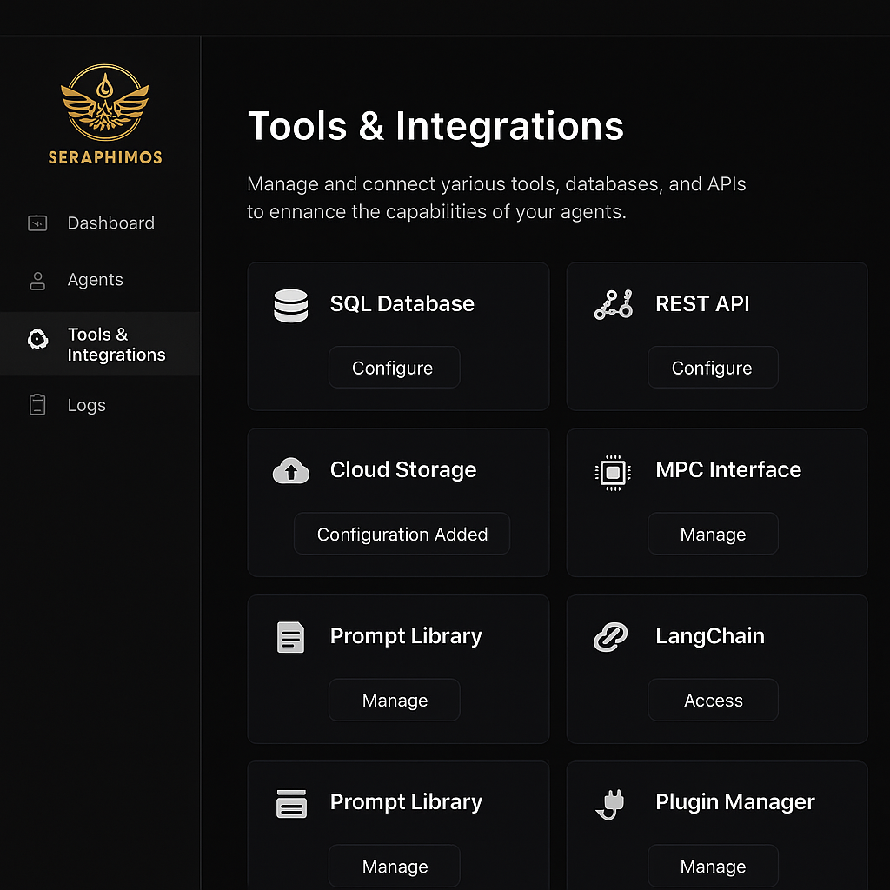
Tools & Integrations
Tool, Hook, and Integration center
Elements
Tools list (with on/off toggles): e.g., RAG, web search, API call agent, database connector
Integration panel: e.g., mock APIs, Google Sheets, etc.)
Logic Flow
Pull available tools:
GET /tools/list
Enable/disable tools:
POST /tools/{toolID}/toggle
For OAuth services:
Initiate GET /auth/integrations/{service}
Store tokens securely
Actions
When agent is run, it checks tool availability
Use-case specific tools (e.g., "Google Sheets Connector") are activated per prompt or chain
Notes:
© Copyright PresentationGO.com – The free PowerPoint and Google Slides template library

Slide 7
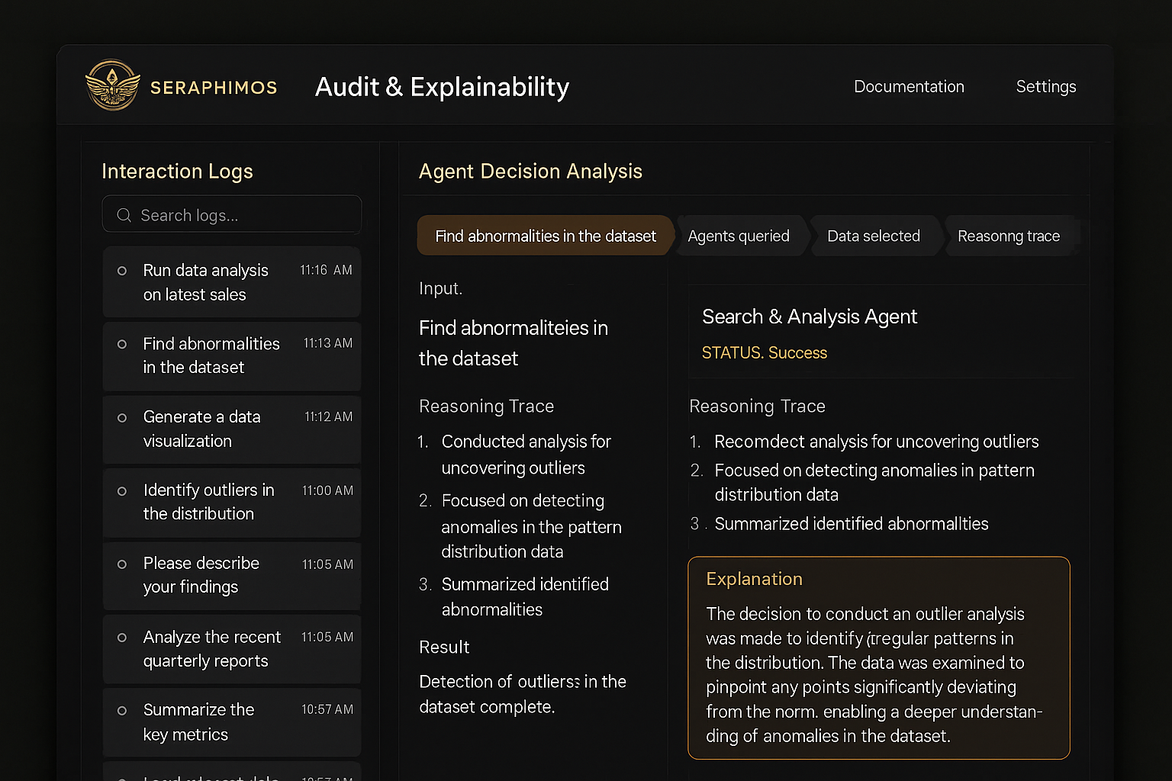
Audit & Explainability
For government / enterprise trust.
Elements
Activity log with chain of actions per agent
Output traceability graph
“Why did this agent make this decision?” modal
Security checkpoint logs (if enabled)
Logic Flow
Load agent execution records:
GET /audit/agents
Click into run:
Loads full trace from GET /agent/{id}/trace
Explainability modal:
Uses GET /agent/{id}/rationale
Shows model confidence, memory path, and input attribution
Security
Role-restricted: Only Admins and Auditors
Export to JSON or CSV: POST /audit/export
Notes:
© Copyright PresentationGO.com – The free PowerPoint and Google Slides template library

Slide 8
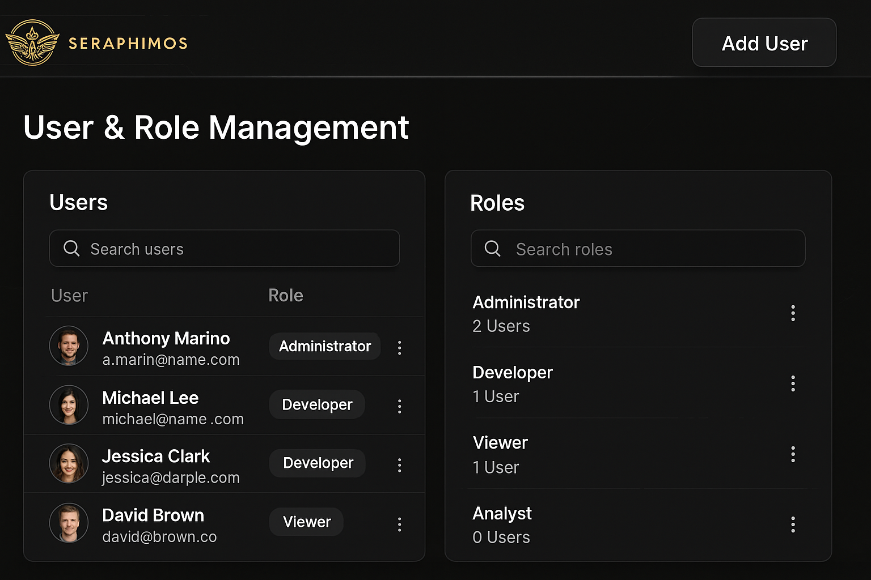
User & Role Management
Security First.
Elements
View user list
Assign roles (admin, developer, viewer)
Usage stats per user
Logic Flow
Load user directory:
GET /users/list
Edit roles:
POST /user/{id}/role-update
Track usage:
GET /user/{id}/activity-log
Admin Actions
Suspend user: POST /user/{id}/suspend
Invite user: POST /invite/send
Notes:
© Copyright PresentationGO.com – The free PowerPoint and Google Slides template library

Slide 9
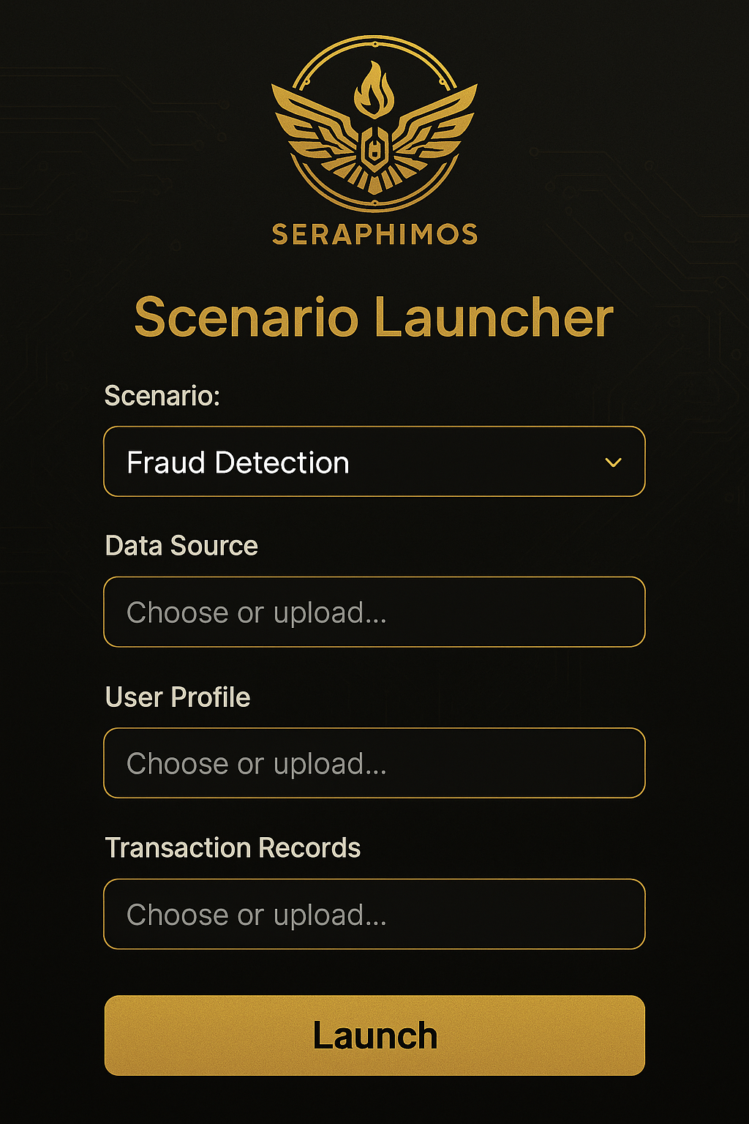
POC Scenarios (Demo Launcher)
Allows investor or pilot user to launch real-world scenarios.
Elements
Predefined “Runbook Templates”: e.g., Intel Fusion, Procurement Auto-Draft, Legal Review Bot
1-click launch of agent orchestration tied to that use case
Result/output viewer
“Send to human” button (for escalation/demo)
Logic Flow
List demo scenarios:
GET /demo-scenarios/list
Click to launch:
Auto-fills agent config and prompt canvas
Executes with POST /demo/run/{scenarioID}
Outputs viewer:
Loads responses as JSON from /demo/{runID}/output
Includes evaluation rating from GET /demo/{runID}/scorecard
Notes:
© Copyright PresentationGO.com – The free PowerPoint and Google Slides template library

Slide 10
Shared Global Flows
Session Check (every screen):
Validates token with /auth/session/validate
Agent Error Handling:
Any crash pushes to /notifications
State Persistence:
Local cache and cloud save via /state/sync

Slide 11

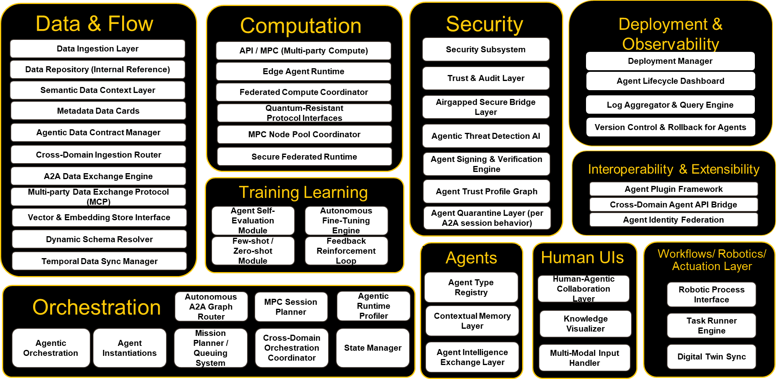
SeraphimOS Capabilities
System Capabilities
Orchestration / Mission Planner: Queueing, prioritization, and parallel agent deployment.
Agent Runtime & Memory: Agents learn, recall, and adapt across sessions and systems.
Airgapped Security Layer: One-way signed data pipelines with scan and rollback functions.
Data & Context Pipeline: Structured ingestion, storage, and semantic retrieval for agents.
Advocacy & Lead Bot Layer: Custom built for each particular engagement.
Threat AI: Live scanning of agent behavior with auto-quarantine and rollback.
Zero-Shot Orchestrator: Compose and execute novel workflows without human scripting.
Plugin & API Bridge: Integration-ready for CRMs, clouds, and third-party platforms.
A secure, orchestrated agentic stack for the AI-native enterprise.
Use Cases
Airgapped LLM deployments
Lead gen + advocacy bots for economic development
Enterprise knowledge automation
Tactical agent orchestration (DoD/Civil)
Notes:
Subcapability Roadmaps

Slide 12
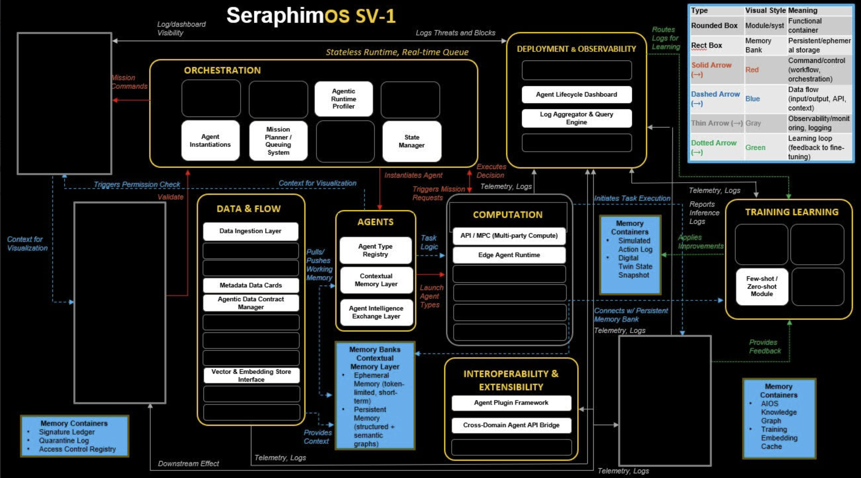
SV-1 for POC

